Slide 1
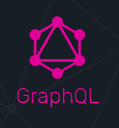
What is all the fuss about GraphQL

Slide 2
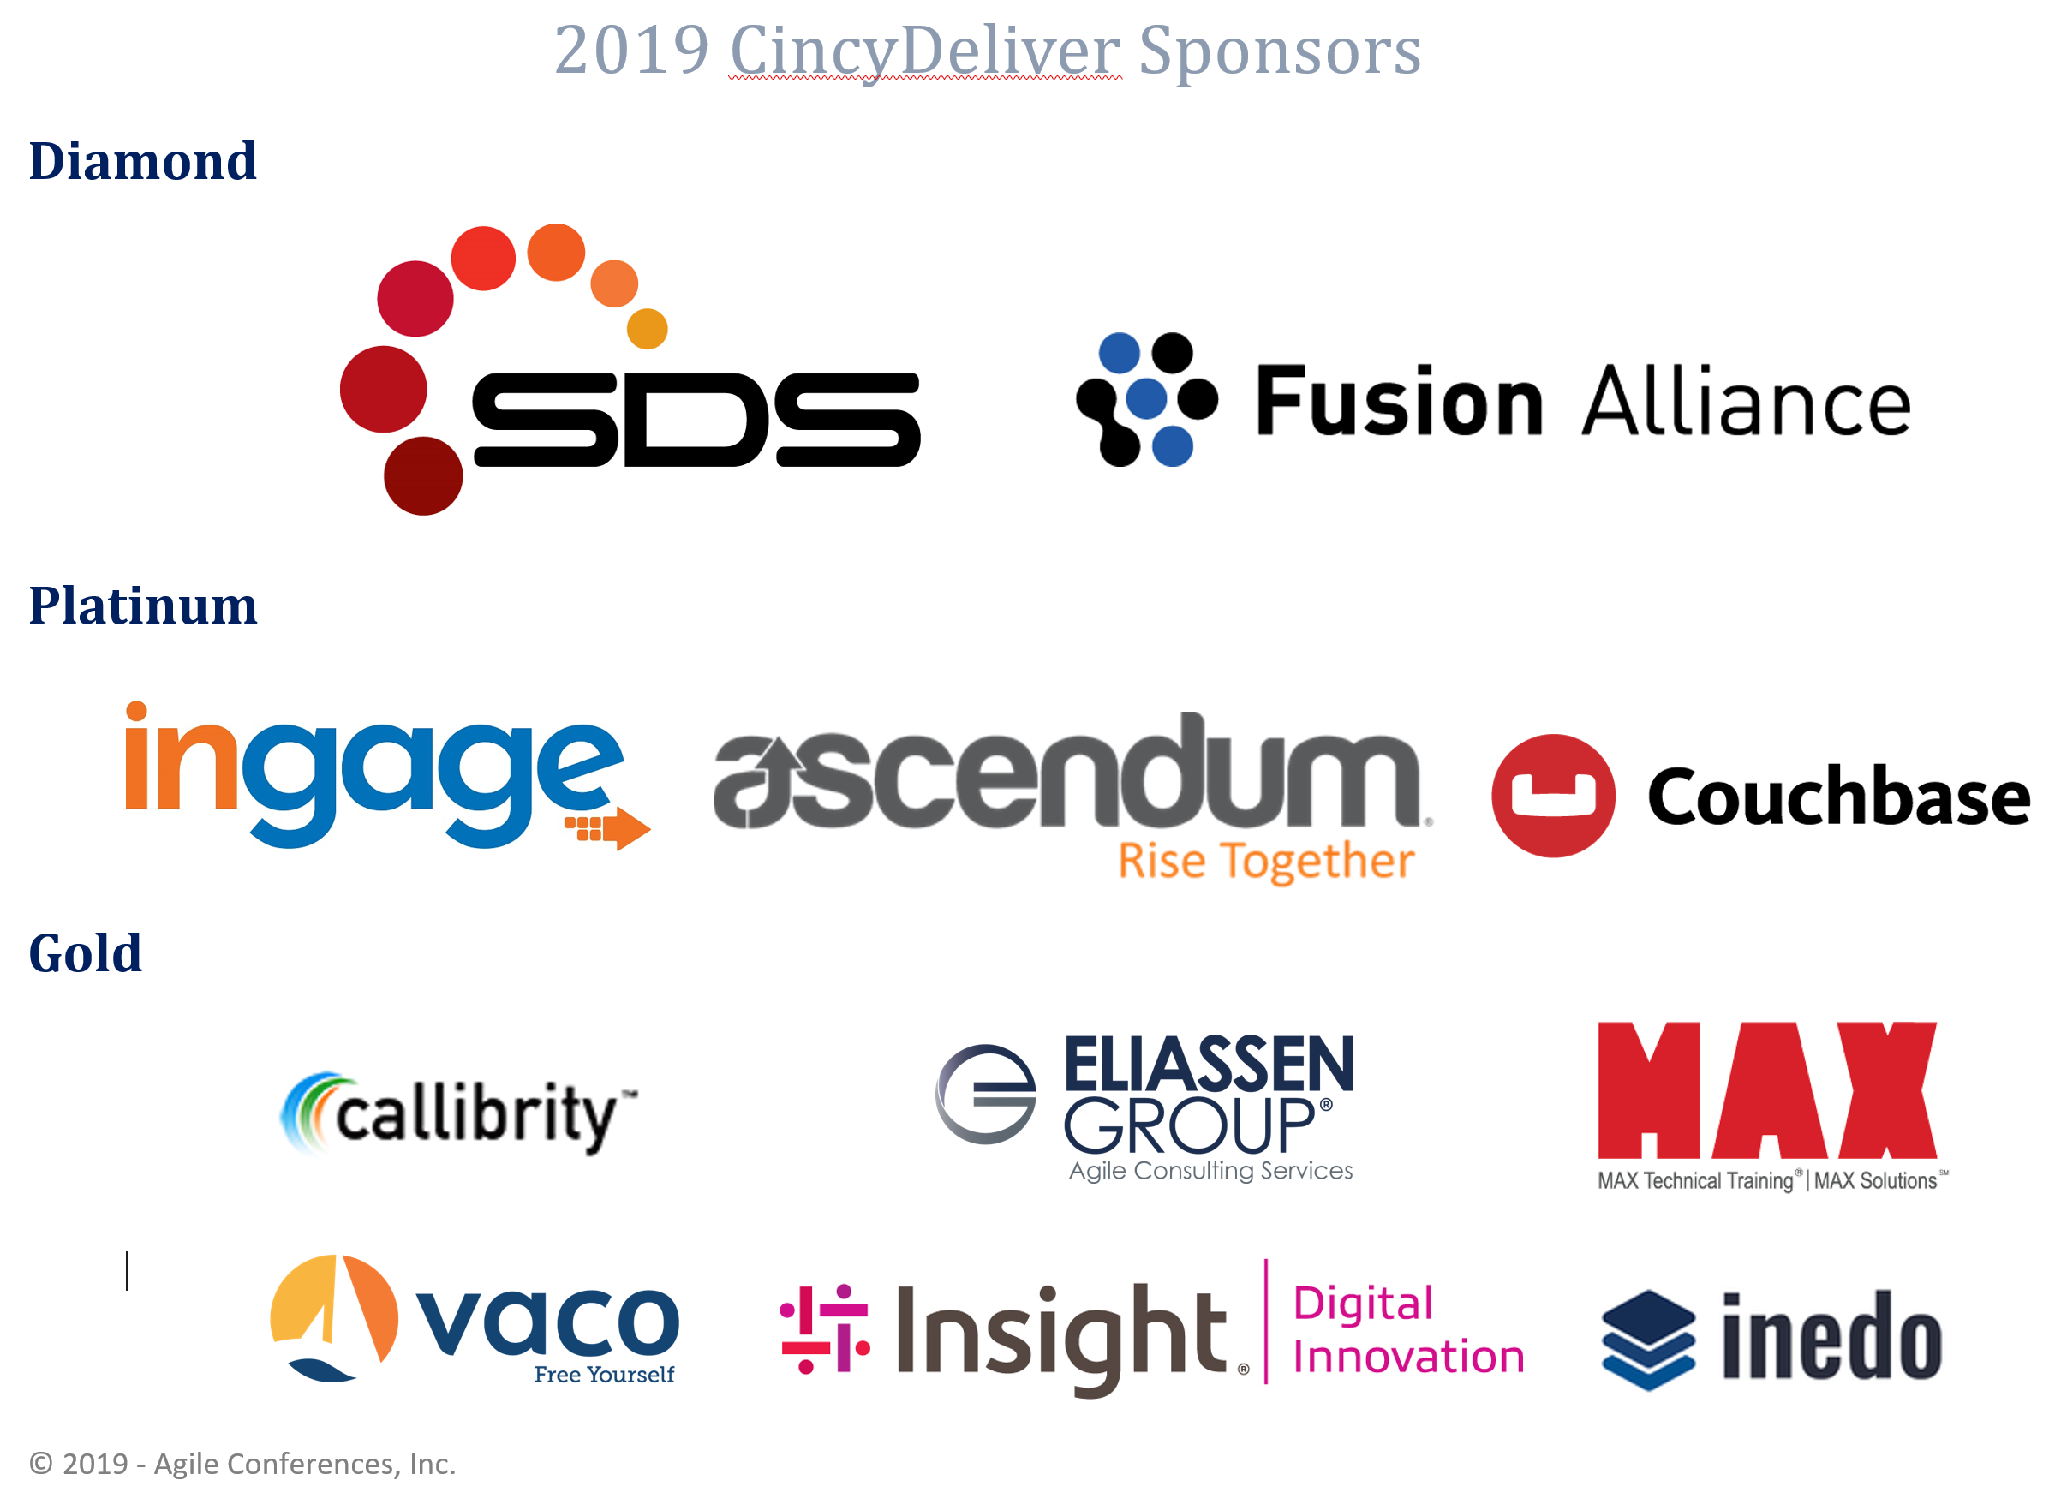
CincyDeliver 2019 Sponsors

Slide 3


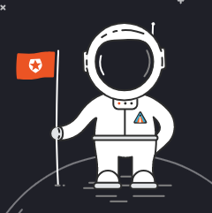
My Intro
Baskar Rao
Twitter - baskarmib
https://www.linkedin.com/in/baskarrao-dandlamudi
baskarrao.dandlamudi@outlook.com
https://github.com/baskarmib

Slide 4
Agenda
History of API Architectures and Clients
Overview of Graph QL
GraphQL Supported Platforms
Overview of GridSome
Demo of Blog to GridSome
Further Resources for Learning

Slide 5
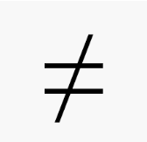
Graph Database
GraphQL

Slide 6





Evolution of Clients
Notes:
There were normal clients – desktops. Then came mobile devices. And today there are numerous clients desktops, mobile devices, IOT Devices. All these devices send data multiple number of times to APIs and fetch data from API. It is very important to make sure that performance of these applications are not impacted.
Application Caching , Geo Location APIs , Increased Processing Power of Hardware , Scale In and Scale Out applications based on load though all these help in improving the performance of applications, the real bottleneck or challenge lies with the round trip to servers.

Slide 7
History of Architectures
Monolithic API
GraphQL API
Microservice /REST API
SOA Based API
grpc
Past
Present
Future
Notes:
From Monolithic API to current Micro Service API application architectures have evolved to support below aspects
Ease of Maintenance - Develop, Deploy and Retire applications easily
Agile Development - Respond to business changes fast
Self Healing and Less Dependent Components of Applications
Increase the Speed of Response time and Performance of Applications

Slide 8
Common Problems in REST API
REST API helps to solve many scenarios.
As the functionalities change, the endpoints change.
Different clients expecting different results would result in endpoint change.
API might be returning major chunk of whole table, and this comes with a cost to network.

Slide 9
Common Problems in REST API
EndPoint 1
GraphQL
EndPoint 2
Notes:
If we have two clients – Web Application and a mobile application and each require different fields. In REST API this would result in having two different Endpoints and if there are any changes in field we need to update all the components to get the new properties. GraphQL solves this. Being Declarative Data Language the clients can specify which fields they need and avoiding the case to have two different endpoints.

Slide 10
Overview of Graph QL
Graph QL is maintained and open sourced by Facebook Engineers.
Graph QL is declarative data query language
Specify what you want and get the same
Reduce Round Trips between client and server
Makes development easy and respond to changes soon
Graph QL can be implemented in any language of choice and architecture of choice.
C# / .NET, Clojure ,Elixir, Erlang , Go, Groovy, Java, JavaScript, PHP, Python, Scala, Ruby

Slide 11
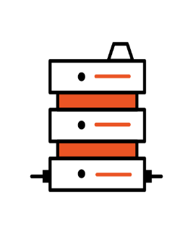

Overview of Graph QL
Traditional SQL is used to query database.
Graph QL can be used to query anything. Client sends query to API and API can query database, filesystem, other graphQL API etc.
SQL
Graph Query

Slide 12
GraphQL vs SQL
GraphQL | SQL
Query | Select
Mutation | Insert, Update,Delete
Subscription

Slide 13
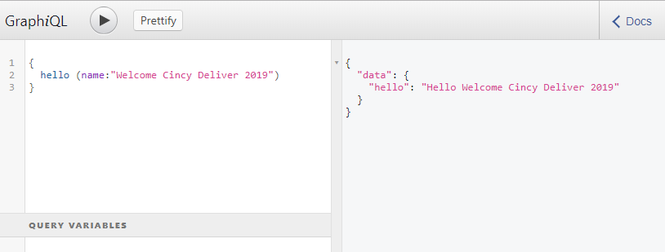
GraphQL vs SQL
Query in GraphQL is set of string sent in the json body.
Fragments can be used to define reusable columns

Slide 14
GraphQL vs SQL
SQL
select empname, department from Employee where employeeId = 5
Graph QL
{
employee(employeeid : 5) { empname
department}
}

Slide 15
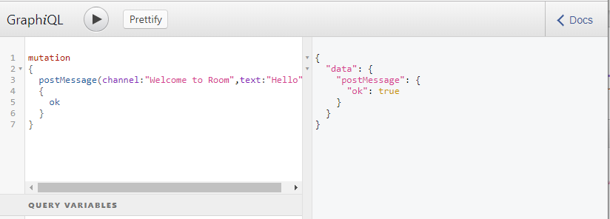
GraphQL vs SQL
Mutation in GraphQL is used to perform data changes.

Slide 16
GraphQL vs SQL
Subscriptions is used for detecting changes to data
These provide a way to get real time updates using web sockets
In SQL we will not be able to get the change notifications directly to client, it would involve multiple hacks using Signal R and other libraries.

Slide 17
Graph QL Platforms
There are different Graph QL clients like Relay developed by Facebook which couples well with React and React Native
Apollo Client is another popular client which is framework agnostic.
Hasura provides Graph QL on top of Postgres and there are certain limitations compared to Apollo.

Slide 18

What is Gridsome
Gridsome provides Graph QL support to Vue Js. It has been inspired from Gatsby which is for React World
Gridsome can be used to develop PWA applications and static sites using markdown
Gridsome provides JAMstack support to Vue Js world

Slide 19
What is Gridsome
Easy to get started and learn
Knowledge of HTML, Vue and JavaScript and Node Js
In Gridsome pages are created using Vue Components
Gridsome supports routing by page name.

Slide 20
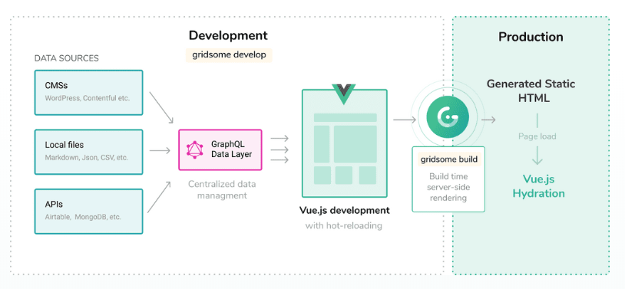
What is Gridsome

Slide 21
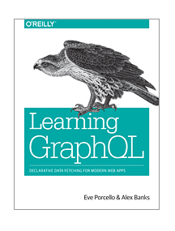
Reference
https://gridsome.org/
https://graphql.org/
https://www.graphqlbin.com/v2/new
https://jamstack.org/
https://identicons.dev/ Server, API and Other Images by Auth0

Slide 22
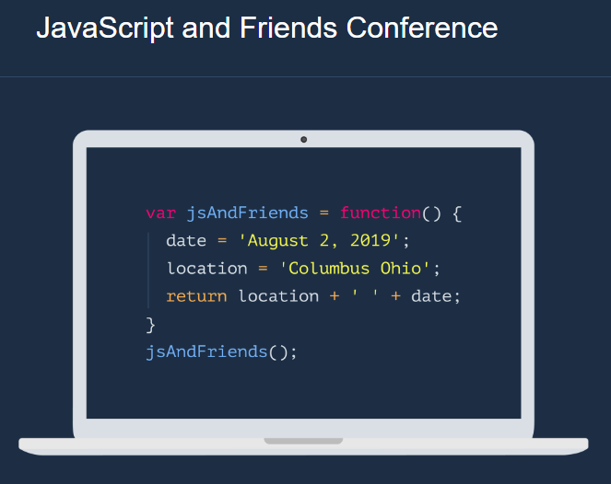
JavaScript Themed Conference
https://www.javascriptandfriends.com/

Slide 23

Questions
Thank you Cincy Deliver 2019
https://www.linkedin.com/in/baskarrao-dandlamudi
baskarrao.dandlamudi@outlook.com
https://baskarrao.wordpress.com/
https://github.com/baskarmib

